Slide 1
Linguistic relativity and grammatical number
A comparison of native Slovenian and native English speakers
Ajda Krišelj
University of Edinburgh 2020 graduate
in Cognitive Science (Humanities)

Slide 2
BACKGROUND
Linguistic relativism/linguistic relativity/Saphir-Whorf theory:
the language we speak influences the way we think
Very controversial debate, with evidence on both sides
Hard to prove, because it is hard to prove thoughts
Evidence in favour of this theory found in domains of grammatical gender (Phillips & Boroditsky, 2003), frames of reference, spatial categories and noun types (Reinez & Prinz, 2009)
This study wanted to discover whether grammatical NUMBER also shows effects of linguistic relativism

Slide 3
Slovenian versus English grammar
SLOVENIAN
3-way grammatical number distinction: singular, dual, plural
(miza [sg.], mizi [dual], mize [pl.])
Marks number by changing the sufix
3 grammatical genders for adjectives and nouns: female, male, neuter
ENGLISH
2-way grammatical number distinction: singular, plural
(table [sg], tables [pl])
Marks number by adding a suffix
No grammatical gender distinction
Do these grammatical differences influence our mental representations?

Slide 4
HYPOTHESES
Slovenian native speakers will have the category of dual more developed and prominent in their brain, so they will group items based on number more than based on type (in the dual-plural distinction) in contrast to English native speakers, who will group by type rather by number
Speakers of non-dual dialects of Slovenian will behave like English native speakers (included so we avoid cultural bias)

Slide 5
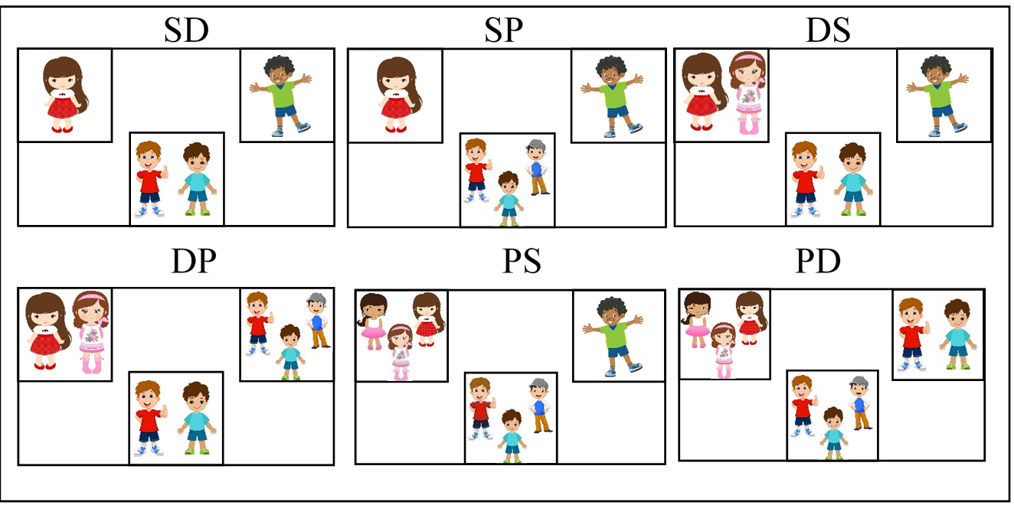
METHODS
Online using Qualtrics survey software
Data analysis in R, factorial ANOVA
Grouping task:
6 conditions,
36 pictures,
human, animal, object items,
half masculine, half feminine (in Slovenian)
Example of all conditions for the picture 1a – boy (slo: fant). There were 36 complete sets like this one in the experiment.

Slide 6
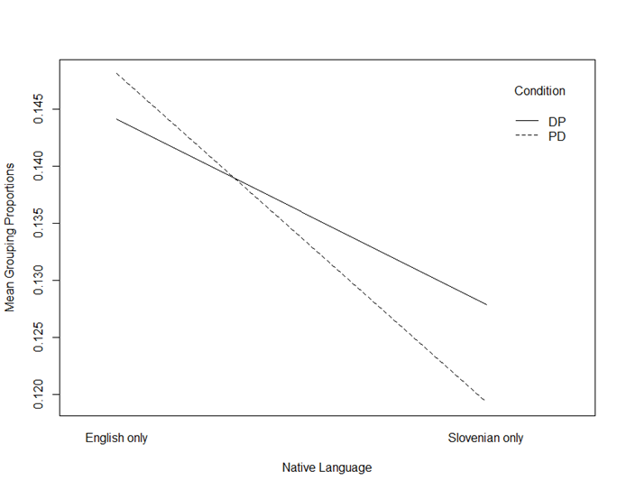
RESULTS
MAIN HYPOTHESIS:
No statistical difference in grouping of the critical conditions between Slovenian and English native speakers – fail to reject the null hypothesis
A small statistical difference was found between dual and non-dual dialects of Slovenian
An interaction plot showing how the mean grouping proportions of Dual-Plural and Plural-Dual conditions interact with the native language of participants.

Slide 7
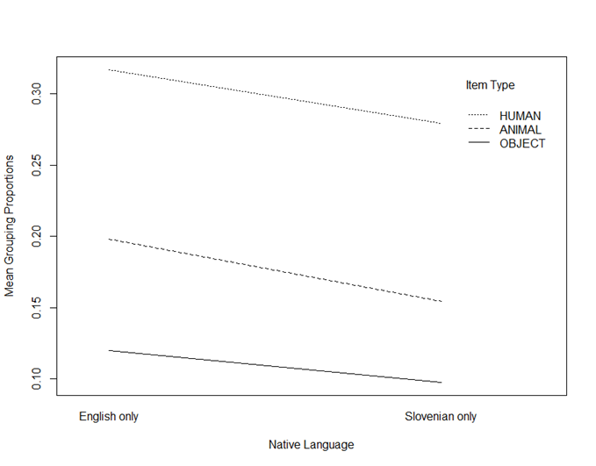
SOME INTERESTING DISCOVERIES
Participants grouped pictures of humans significantly more often by number than by type (both Slovenian and English native speakers)
Perhaps:
Different humans seem more like each other than different objects (e.g. two men and two kings look more like each other, than two chairs and two laptops)
Number of people bears more meaning than the number of, for example, erasers
A distinction between a single person, a pair of people, and a group of three people is more important to our everyday lives than a distinction between one, two, or three chairs
An interaction plot of how the item type and native language groupings interact.

Slide 8
LIMITATIONS
A hypothesis test showed that people who solved the survey on their phone grouped pictures by number more.
Since all the Slovenian participants were fluent in English, the English number system could have affected their cognitive representations of numbers.
The experimental design was not appropriate for testing the hypotheses. Participants often chose to group pictures by colour instead of by number or by type.

Slide 9
CONCLUSIONS
The results of this study failed to support the theory of linguistic relativism and are, therefore, not in line with the findings of Phillips and Boroditsky (2013)
There were some interesting discoveries found, which need to be explored further
More statistical analysis of gathered data
Another task that would test speaker respresentations

Slide 10
THANK YOU FOR LISTENING!
If you have any questions, do not hesitate to ask now or contact me later on Discord or email me on ajda.kriselj@gmail.com.

