Slide 1
Crosslinguistic influence on adult L2 learners’ acquisition of Chinese classifiers
Jiahuan Zhang
jz525@cam.ac.uk

Slide 2
1. Introduction
A Chinese classifier is structurally obligatory within an NP when the head noun is enumerated as demonstrated below (Jiang, 2017; Ke, 2018; Zhang, 2005), e.g., classifier tiao (refers to long, thin, and flexible objects) must be inserted to convey the meaning of “two ropes”.
liang tiao shengzi
two CL rope
‘two ropes’
The four types of classifiers based on primary feature (Gao & Malt, 2009).
animacy, inanimacy, shape, concept
Concrete
Abstract

Slide 3
2. Literature review
2.1 Crosslinguistic influence (CLI)
Similarities-easiness
Similarities-difficulties
Contrastive analysis hypothesis (CAH): similarities and differences make L2 acquisition easier and more difficult respectively (Lado, 1957).
L1-L2 similarities impede L2 learning given a prerequisite that similarities in languages incur confusions (Anderson, 1984).

Slide 4
2. Literature review
Natural Order Hypothesis (Krashen, 1987).
Processability Theory (PT) (Pienemann,1998).
Numeral Classifiers Accessibility Hierarchy (NCAH) (Craig, 1986): less marked classifiers (animate human) are easier to acquire (Lee et al, 2015).
2.2 Sequential acquisition
predictable order, and it was not influenced by instruction
undergo certain distinct developmental stages
animate human, animate non-human, shape and function

Slide 5
2. Literature review
Similarities-easiness
Similarities-difficulties
Sequential acquisition
Individual differences
2.3 Overview of factors that influence classifier acquisition
Task type

Slide 6
2. Literature review
Does L1 affect classifiers acquisition?
Do tasks influence the test performance?
Is there a developmental sequence of acquiring different types of classifiers?
Do individual differences affect the acquisition?
2.4 Research questions

Slide 7
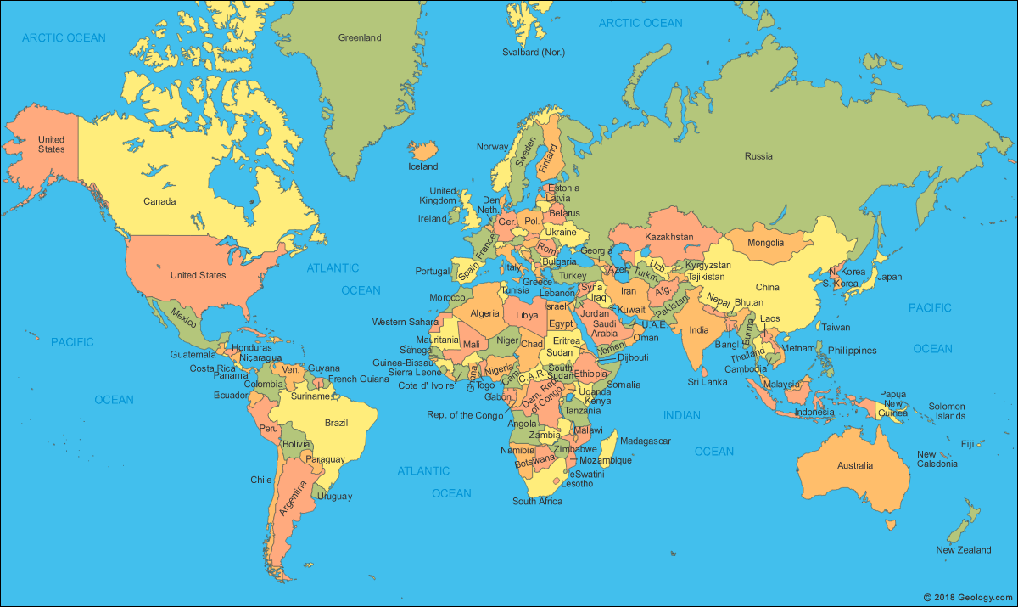
3. Methodology
3.1 Participants: 50 adult Chinese L2 learners (16 males and 34 females, mean age 21.54, age range 18-34), HSK 3-4 (intermediate level of Chinese)
Copyright: 2018 Geology.com

Slide 8
3. Methodology
3.2 Materials: Chinese language test concerning classifiers
Table 1. Potential classifiers
Number | Classifiers | Items | Annotation
1 | ge | jia ‘home’ | *
2 | ge | fangjian ‘room’
3 | zhang | zhaopian ‘pic’ture
4 | dui | fuqi ‘couple’ | *
5 | ge/kou | ren ‘people’/ nanhai ‘guy’/ nvhai ‘girl’ | *
6 | jian | yifu ‘clothes’
7 | tiao | kuzi ‘trousers’
8 | ge | zhentou ‘pillows’
9 | bei | putaojiu ‘wine’ | *
10 | zhi | mao ‘cat’ | *
11 | tiao/zhi | gou ‘dog’ | *
12 | zhang | shafa ‘sofa’ | *
13 | zhang | zhuozi ‘table’ | *
14 | ge | guizi ‘cupboard’ | *
15 | pen/zhong | zhiwu ‘plants’
16 | ke | shu ‘tree’ | *
17 | tiao | jinyu ‘goldfish’ | *
18 | ge | jinyugang ‘goldfish bowl’ | *
19 | ge | huaping ‘vase’ | *
20 | zhi | meihua ‘prunus mume’
21 | ge/zhang/fu | fuzi ‘the character of fu’ | *
22 | shan | chuanghu ‘window’
23 | mian | qiang ‘wall’
24 | dong | lou ‘building’
25 | zhi | niao ‘bird’
26 | duo | yun ‘cloud’
27 | ge | shike ‘moment’ | *
28 | ge | wuhou ‘afternoon’
Fig 1. Picture (source: Zhang, 2019)

Slide 9
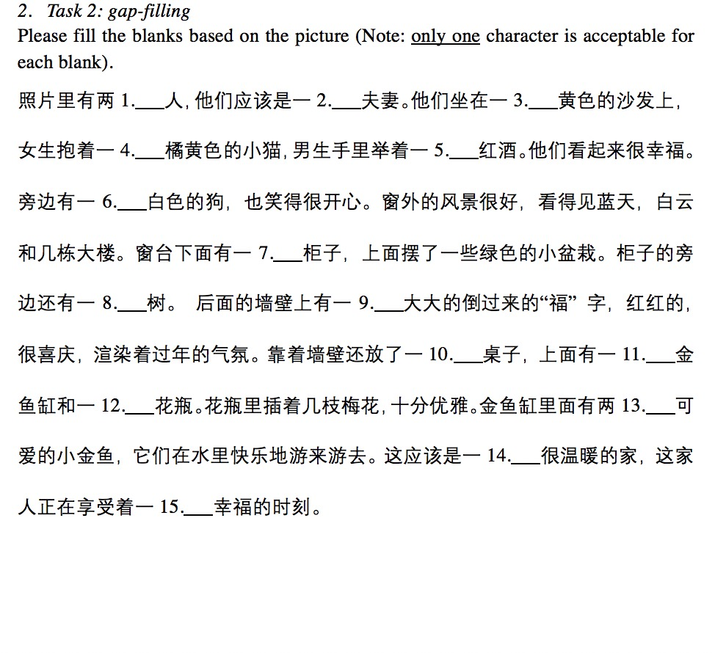
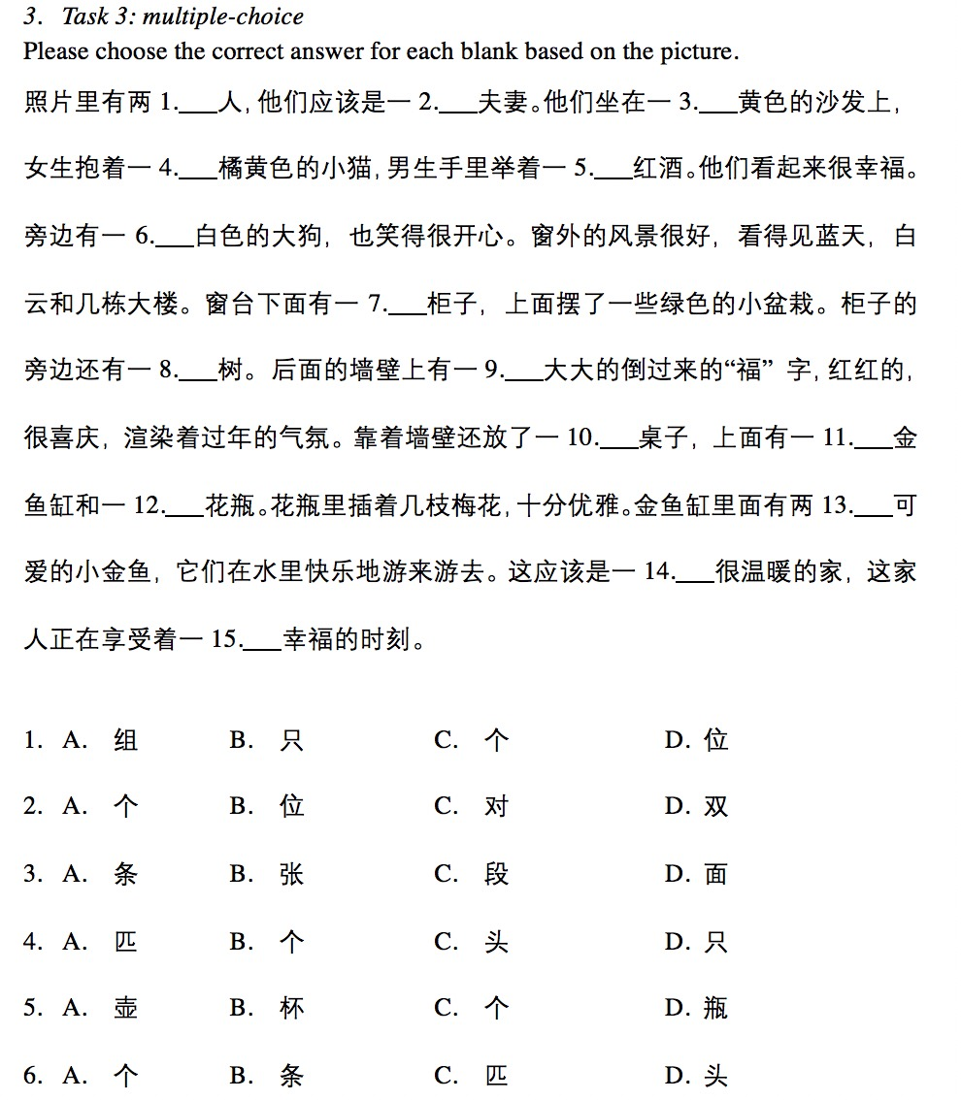
3. Methodology
3.2 Materials: Chinese language test of classifiers
Assumption of difficulty: task 2 > task 3> task 1

Slide 10
3. Methodology
3.2 Materials: Chinese language test of classifiers
Table 2. Classifiers used and types
Question | Classifier-object | Type
1 | ge-people | animacy
2 | dui-couple | concept
3 | zhang-sofa | shape
4 | zhi-cat | animacy
5 | bei-wine | shape
6 | tiao-dog | shape
7 | ge-cupboard | inanimacy
8 | ke-tree | inanimacy
9 | fu-calligraphy | inanimacy
10 | zhang-table | shape
11 | ge-vase | inanimacy
12 | ge-goldfish bowl | inanimacy
13 | tiao-goldfish | shape
14 | ge-home | concept
15 | ge-moment | concept

Slide 11
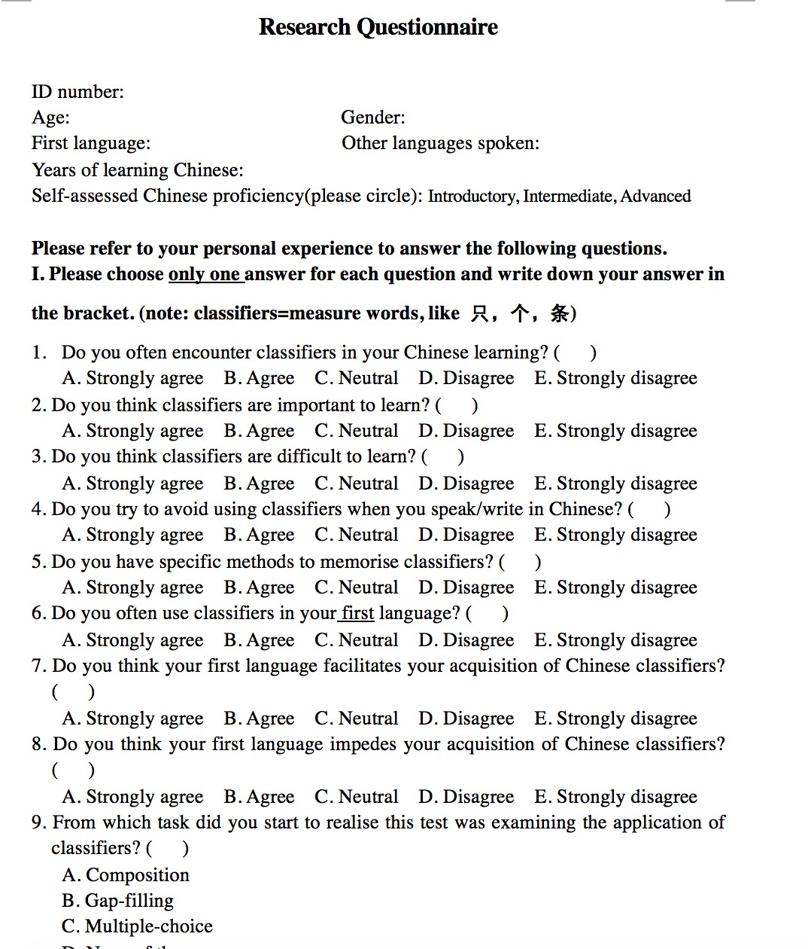
3. Methodology
3.2 Material: post-test questionnaire

Slide 12
3. Methodology
3.3 Coding & analysis
Manually coding
Accuracy percentage
Statistical modelling
PCA model
LMER model
Logistic regression model
T-test
Syntactic correctness
Semantic correctness
Value: 1 or 0
Dependent variable

Slide 13
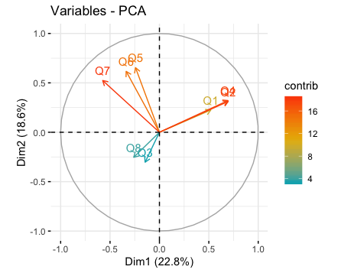
4. Results
4.1 Principal component analysis (PCA)
Variable 2
Variable 1
Variable 3
Fig 2. Biplot of PCA

Slide 14
4. Results
4.1 PCA
Table 3. Three variables created by the biplot of PCA

Slide 15
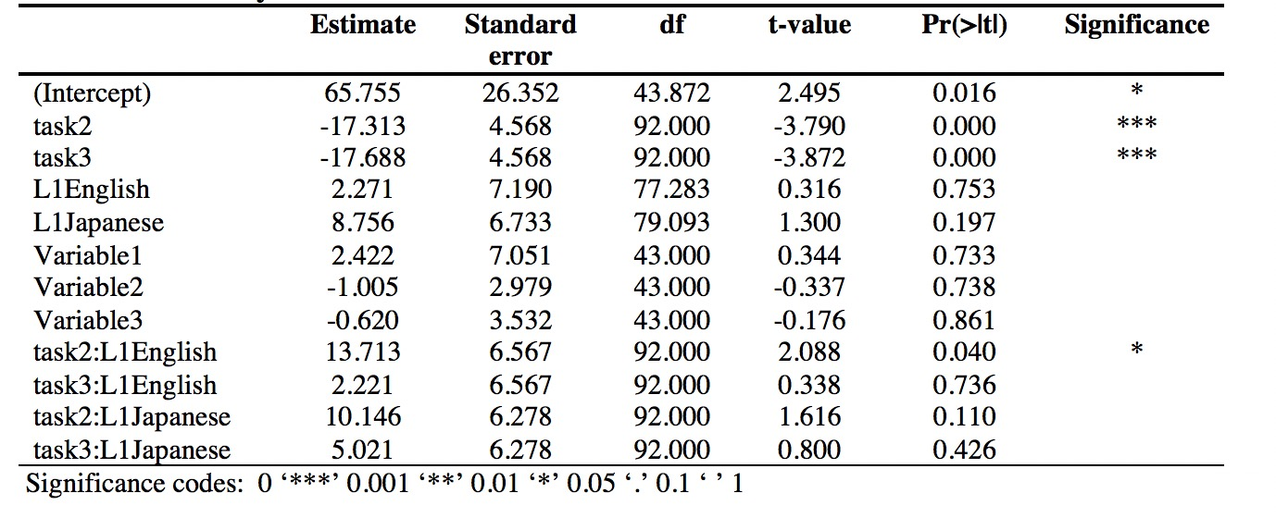
4. Results
4.2 Linear mixed-effects regression model: interaction of L1 and task
formula: score~L1*task+variable1+variable2+variable3+(1|participant)+(1|classifier)
Table 4. Summary for LMER model

Slide 16
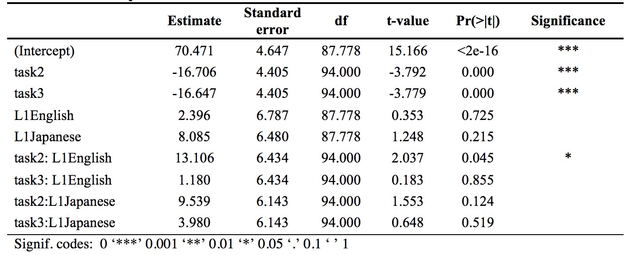
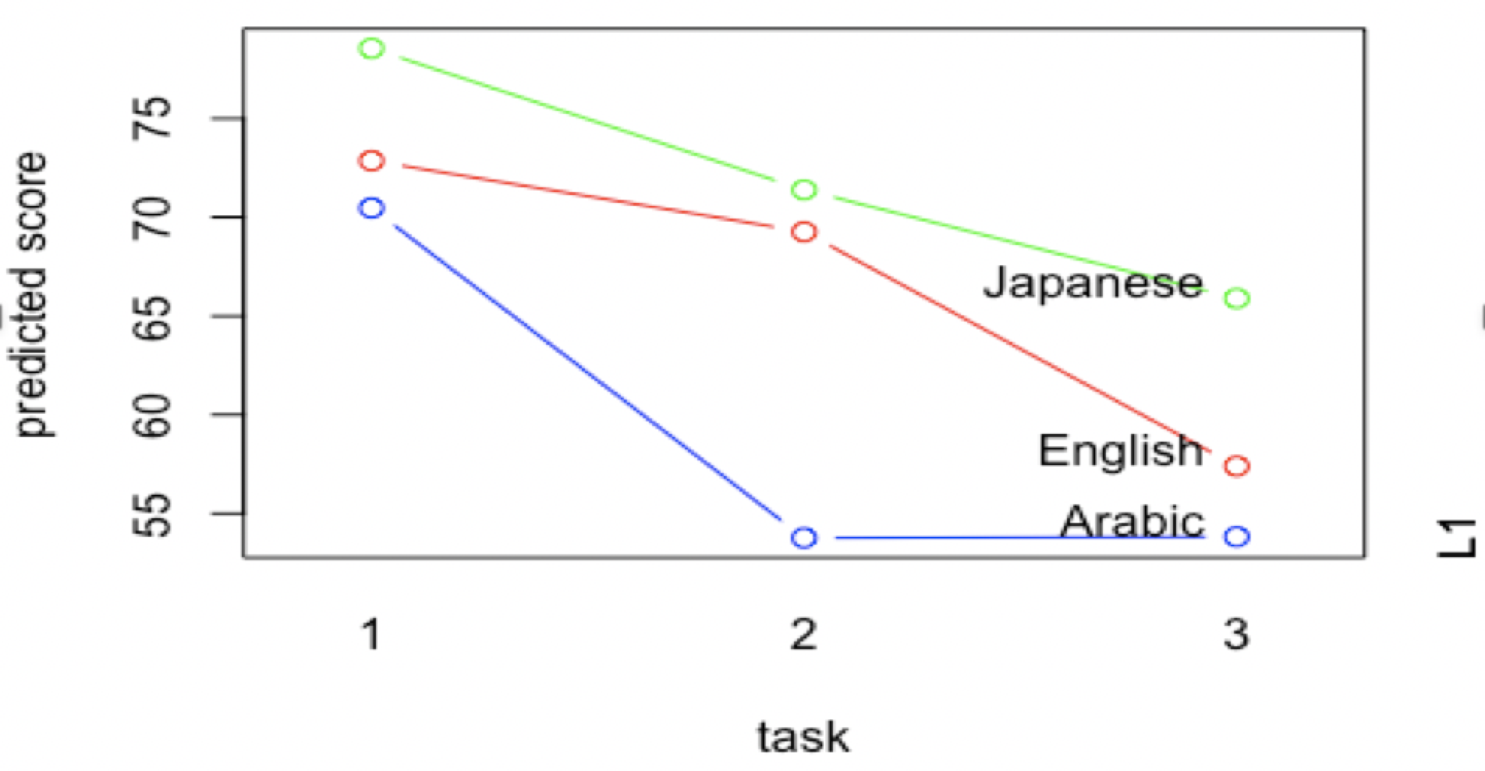
4. Results
4.2 Final LMER model: L1 * task
formula: score~L1*task+(1|participant) +(1|classifier)
Table 5. Summary for final LMER model
Fig 3. Model prediction for score

Slide 17
4. Results
4.2 T-test: L1 & task
Individual token of using the generic classifier ge in task2 :
Arabic 4.53, English 6.13, Japanese 4.88
Two sample t-test: significant difference between Arabic and English (p < 0.05)

Slide 18
4. Results
4.3 Logistic regression model: sequential acquisition
formula: score ~ L1*type +(1|participant) +(1|classifier)
Table 6. Summary for logistic model
Fig 4. Model prediction for likelihood of type scoring
Predicted sequence of type
shape→ animacy→ inanimacy→concept

Slide 19
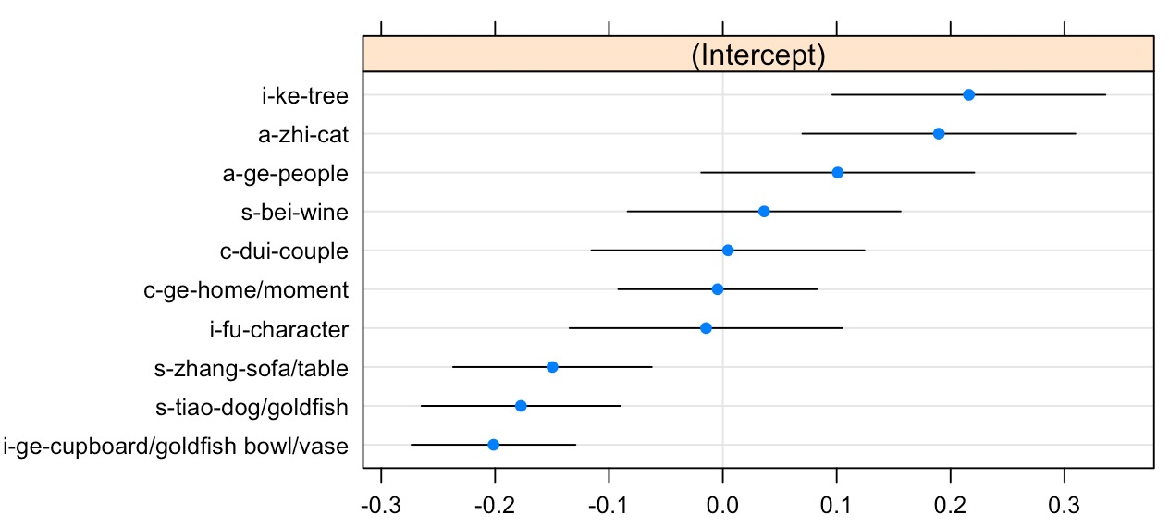
4. Result
4.3 Logistic regression model: effect of individual classifiers on top of types
formula: score ~ L1*type+(1|classifier), ranef (), type-classifier-object
Fig 5. Dotplot for random effects of individual classifiers

Slide 20
5. Discussion
5.1 Effects of L1
L1 is not a significant predictor of score.
Similarities facilitate learning:
Liang (2009): Korean speakers outperformed English speakers in classifier acquisition.
See also Polio (1994) for the comparison of English and Japanese speakers.

Slide 21
5. Discussion
5.2 Interaction of L1 and task
Interaction of task and L1 was found significantly different only between Arabic and English L1 in task 2: English participants scored particularly higher than the Arabic counterparts. Two potential reasons:
Nature of task: task 2 offered some leeway for scoring compared to task 3, in which 7 out of the 15 blanks have an acceptable answer of ge (Douglas, 2010).
Testing strategies: English participants’ higher individual token percentage of using ge in task2 (p < 0.05).

Slide 22
5. Discussion
5.3 There tends to be a sequential acquisition: shape→ animacy→ inanimacy→concept
In contrast to Numeral Classifiers Accessibility Hierarchy:
animated human→ animated non-human→ shape (Craig, 1986)
Classifiers with shape-oriented feature were acquired earliest in Chinese L1 acquisition (Chien et al, 2003; Li et al, 2010).
Partially in line with the L1 acquisition of Hokkien and Cantonese: animacy was acquired relatively earlier (e.g., Hu, 1993; Liang, 2009).
Following the general path of L1 vocabulary acquisition:
concrete → abstract (Erbaugh, 1986)

Slide 23
5. Discussion
5.4 Implications
Methodogical: task elicitations may affect interpretation → triangulation.
Pedagogical: language teachers could pay more attention to concept type classifiers.

Slide 24
6. References
Andersen, R. (Ed.). (1984). Second languages a cross-linguistic perspective. Rowley/London/Tokyo: Newbury House Publishers.
Cheong, C. M., Zhu, X., Li, G. Y., & Wen, H. (2019). Effects of intertextual processing on L2 integrated writing. Journal of Second Language Writing, 44, 63-75.
Craig, C (Ed.). Noun classes and categorization. Amsterdam/Philadelphia: John Benjamins Publishing Company.
Douglas, D. (2014). Understanding language testing. New York: Routledge.
Erbaugh, M. S. (2006). Chinese classifiers: Their use and acquisition. In P. Li, L. H. Tan, E. Bates, & O. J. Tzeng, (Eds.). (2006). The Handbook of East Asian Psycholinguistics: Volume 1, Chinese (pp. 39-51). Cambridge: Cambridge University Press.
Gao, M. Y., & Malt, B. C. (2009). Mental representation and cognitive consequences of Chinese individual classifiers. Language and Cognitive Processes, 24(7-8), 1124-1179.
Gafni, R., Achituv, D. B., & Rahmani, G. (2017). Learning foreign languages using mobile applications. Journal of Information Technology Education: Research, 16, 301-317.
Hao, Y. C. (2012). Second language acquisition of Mandarin Chinese tones by tonal and non-tonal language speakers. Journal of phonetics, 40(2), 269-279.
Hu, Q. (1994). The acquisition of Chinese classifiers by young Mandarin-speaking children. PhD dissertation. Boston University, USA.
Kuo, J. Y. C. & Sera, M. D. (2009). Classifier effects on human categorization: The role of shape classifiers in Mandarin Chinese. Journal of East Asian Linguistics, 18(1), 1-19.
Lado, R. (1957). Linguistics Across Cultures: Applied Linguistics for Language Teachers. Michigan: University of Michigan Press.
Lee, C., Simpson, G. B., Kim, Y., & Li, P. (Eds.). (2015). Handbook of East Asian Psycholinguistics (Vol. 3). Cambridge University Press.
Jiang, S. (2017). The Semantics of Chinese Classifiers and Linguistic Relativity. Abingdon: Routledge.
Ke, C. (Ed.). (2018). The Routledge Handbook of Chinese Second Language Acquisition. London: Routledge.
Liang, S. Y. (2009). The Acquisition of Chinese Nominal Classifier Systems By L2 Adult Learners. (Unplished PhD thesis). University of Texas Arlington, the USA.
Krashen, S. (1981). Second Language Acquisition and Second Language Learning. Pergamon, Oxford: Oxford University Press.
Pienemann, M. (Ed.). (2005). Cross-linguistic aspects of Processability Theory (Vol. 30). Amsterdam: John Benjamins Publishing.
Saalbach, H., & Imai, M. (2012). The relation between linguistic categories and cognition: The case of numeral classifiers. Language and Cognitive Processes, 27(3), 381-428.
Stockwell, R. P., Bowen, J. D., & Martin, J. W. (1965). Grammatical Structures of English and Spanish. Chicago: The University of Chicago Press.
Zhang, Y. (2005). Processing and formal instruction in the L2 acquisition of five Chinese grammatical morphemes. In M. Pienemann (Ed.), Cross-linguistic Aspects of Processability Theory (pp. 155-178). Amsterdam: Benjamins.

